Slide 1

Prasanna Karthik Vairam Lecturer Department of Computer Science NUS School of Computing
IT 5007: Software Engineering on Application Architecture
Notes:
Webinar
Ask questions – raise hand or type questions in Q&A

Slide 2
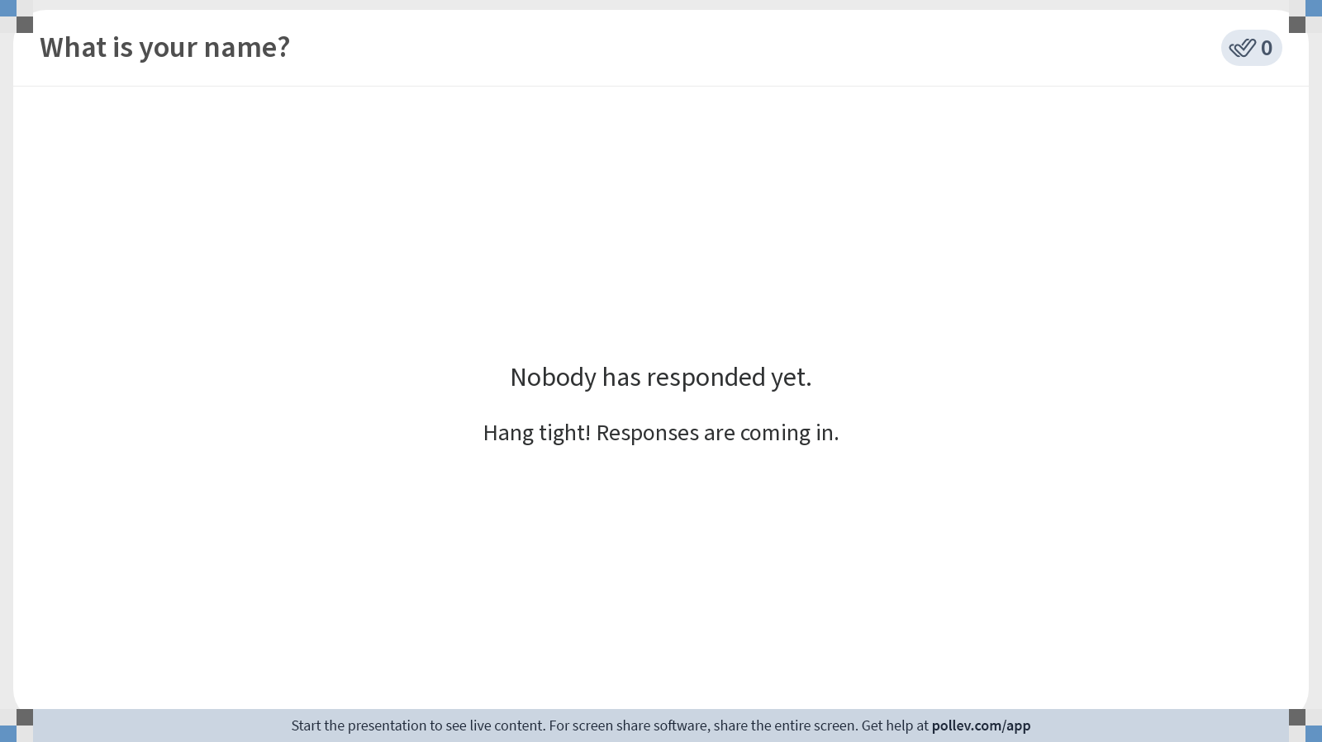
Notes:
Poll Title: Do not modify the notes in this section to avoid tampering with the Poll Everywhere activity. More info at polleverywhere.com/support What is your name? https://www.polleverywhere.com/free_text_polls/pPKvaPyqbFHYKvhNDyI6S

Slide 3
Course Details
Modular Credits: 4 Units
Prerequisite: IT5003 Data Structures and Algorithms
Evaluation Criteria
Project: 50%
Programming assignments: 50%
Lecture Time: Tuesday (6.30 pm- 9.30 pm)
Venue: Seminar Room 1
Lecture Materials: Canvas
Discussions: Canvas
1-1 Questions with instructor: MS Teams Chat (24x7)

Slide 4
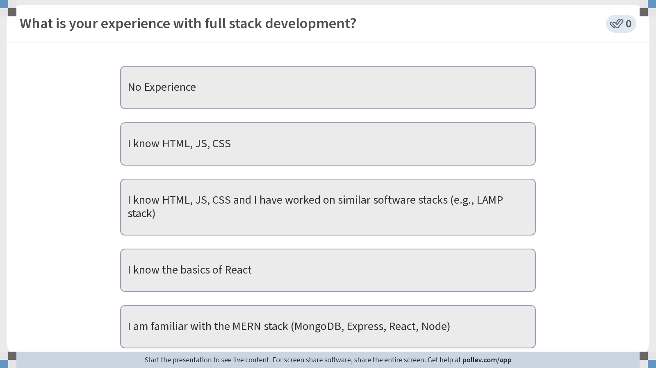
Notes:
Poll Title: Do not modify the notes in this section to avoid tampering with the Poll Everywhere activity. More info at polleverywhere.com/support What is your experience with full stack development? https://www.polleverywhere.com/multiple_choice_polls/vEfUjRnYOIhZFiNMYthOx?display_state=instructions&activity_state=opened&state=opened&flow=Engagement&onscreen=persist

Slide 5
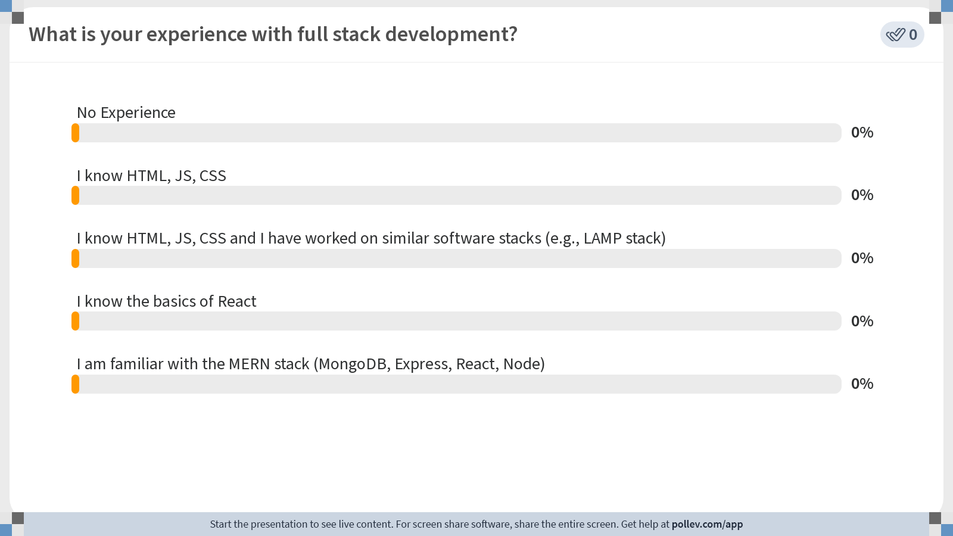
Notes:
Poll Title: Do not modify the notes in this section to avoid tampering with the Poll Everywhere activity. More info at polleverywhere.com/support What is your experience with full stack development? https://www.polleverywhere.com/multiple_choice_polls/vEfUjRnYOIhZFiNMYthOx?display_state=chart&activity_state=opened&state=opened&flow=Engagement&onscreen=persist

Slide 6
Notes:
Poll Title: Do not modify the notes in this section to avoid tampering with the Poll Everywhere activity. More info at polleverywhere.com/support What is your experience with full stack development? https://www.polleverywhere.com/multiple_choice_polls/vEfUjRnYOIhZFiNMYthOx?display_state=chart&activity_state=closed&state=closed&flow=Engagement&onscreen=persist

Slide 7
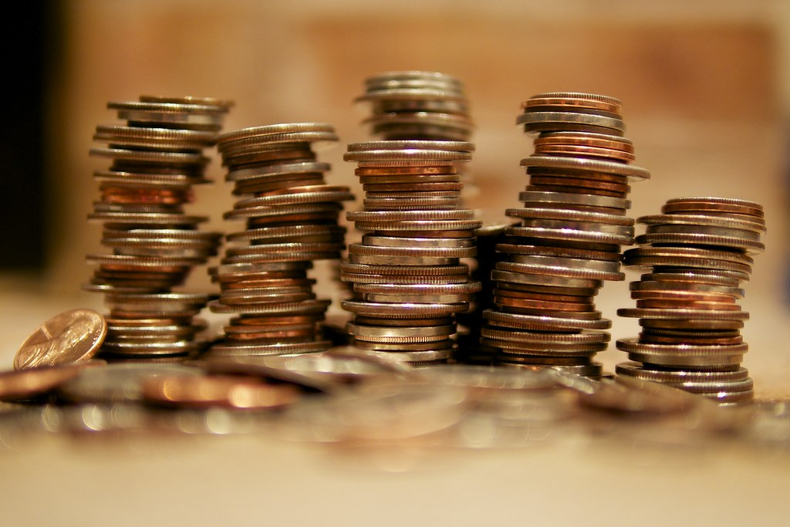
Overview of IT5007
One line summary: Full stack development
Designed with inputs from industry folks!
What does this mean?
Amended with inputs from previous batches
Intended audience: Those who are not exposed to web programming (or) those who are aware of the basics (e.g., HTML, CSS, JS).
Intended Learning Outcomes
Ability to understand and write code for MERN stack.
Understand the architectural principles of full-stack development.

Slide 8

Textbooks
Pro MERN Stack: Full Stack Web App Development with Mongo, Express, React, and Node by Vasan Subramanian

Slide 9
Schedule (First half)
Week | Lecture | CA | Supplementary Materials (Videos/Lab) | Project
1 | Introduction to Software Development and Basics of Web Programming (HTML) | [A1 | Git | [Team
2 | Basics of Web Programming (JS) and CSS |  | HTML website | ]
3 | Web-based Front End Development: React and React components | A1], | React Coding in CodePen | [Title and scope
4 | React State and React Hooks | [A2 | Docker and VS Code | ] [Front-end
5 | Self study: MongoDB basics
6 | Cloud-based back end Development: Express API and GraphQL | A2][A3
 | RECESS WEEK |  |  | Front-end], [Back-end

Slide 10
Schedule (Second half)
Week | Lecture | CA | Supplementary Materials (Video) | Project
7 | GraphQL (continued) | A3] | Webpack codebase
8 | Advanced Topics on web development: Modularization, Integration with 3rd party API | [A4 | Modularization codebase
9 | Advanced Topics on web development: Bootstrap |  | Bootstrap codebase | Back-end],
10 | Advanced Topics on web development:React Router, Web3 | A4] |  | [Advanced Features
11 | Mobile Application Front End Development: ReactNative basics | [A5 | Installation video for React Native setup
12 | Mobile Application Front End Development
13 | Advanced Topics: Cloud Deployment | A5] | Installation video for Amazon EC2 setup
 | READING WEEK |  |  | Advanced Features]
Week | Lecture
7 | Advanced Topics on web development: Integration with 3rd party API
8 | Advanced Topics on web development: React router
9 | Advanced Topics on web development: React forms, React Bootstrap
10 | Mobile Application Front End Development: ReactNative basics
11 | Mobile Application Front End Development
12 | Advanced Topics: Performance of Applications and Design for Security and Privacy
13 | Reserved

Slide 11
Staff
Instructor:
Prasanna Karthik Vairam (Lecturer)
TAs:
Ng Jin Pei
TBD

Slide 12

Right Infringments on NUS Course Materials
All course participants (including permitted guest students) who have access to the course materials on LumiNUS or any approved platforms by NUS for delivery of NUS modules are not allowed to re-distribute the contents in any forms to third parties without the explicit consent from the module instructors or authorized NUS officials

Slide 13
Part-1
Introduction to Software Development
Notes:
Webinar
Ask questions – raise hand or type questions in Q&A

Slide 14
Software Development Ecosystem
Notes:
Webinar
Ask questions – raise hand or type questions in Q&A

Slide 15
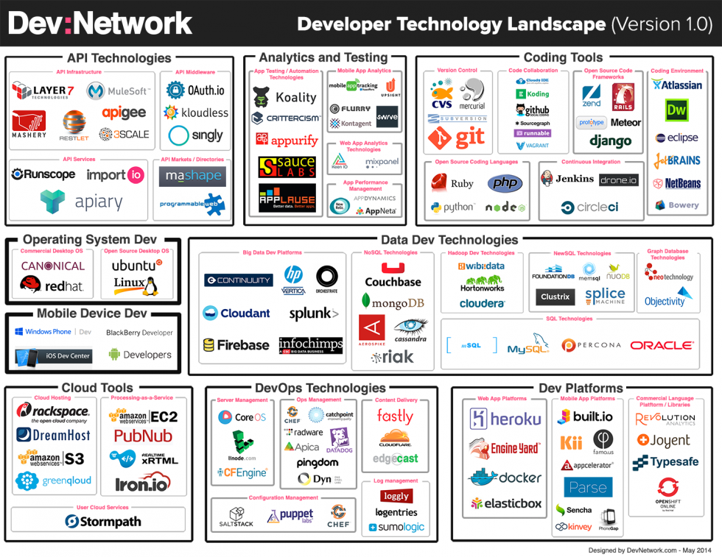
Software Dev Ecosystem Today!

Slide 16

How about tomorrow?
Likely that most of these tools/techniques will be obsolete!
The ecosystem is not static, like, say, IT5003 – DS/Algorithms
Key question in your mind: Why are we here then?

Slide 17
A famous quote from 1981…
"640K ought to be enough for anybody.”
Key takeaway of this module: Be prepared for the future!
But first understand what happened in the past ☺

Slide 18
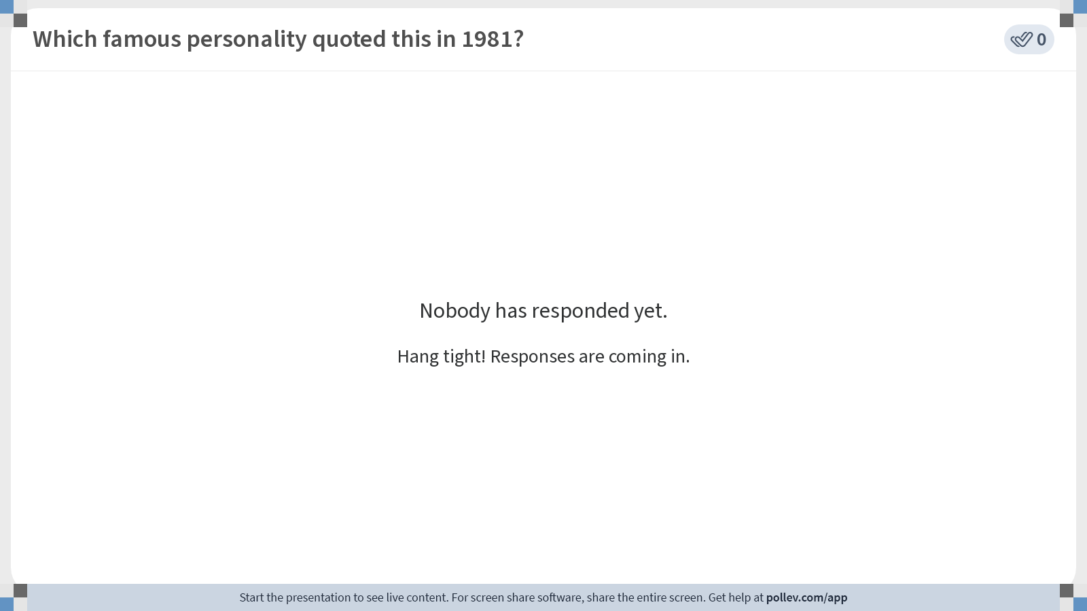
Notes:
Poll Title: Do not modify the notes in this section to avoid tampering with the Poll Everywhere activity. More info at polleverywhere.com/support Which famous personality quoted this in 1981? https://www.polleverywhere.com/free_text_polls/LkqzmEJ6FmUUuOUONk6AU

Slide 19


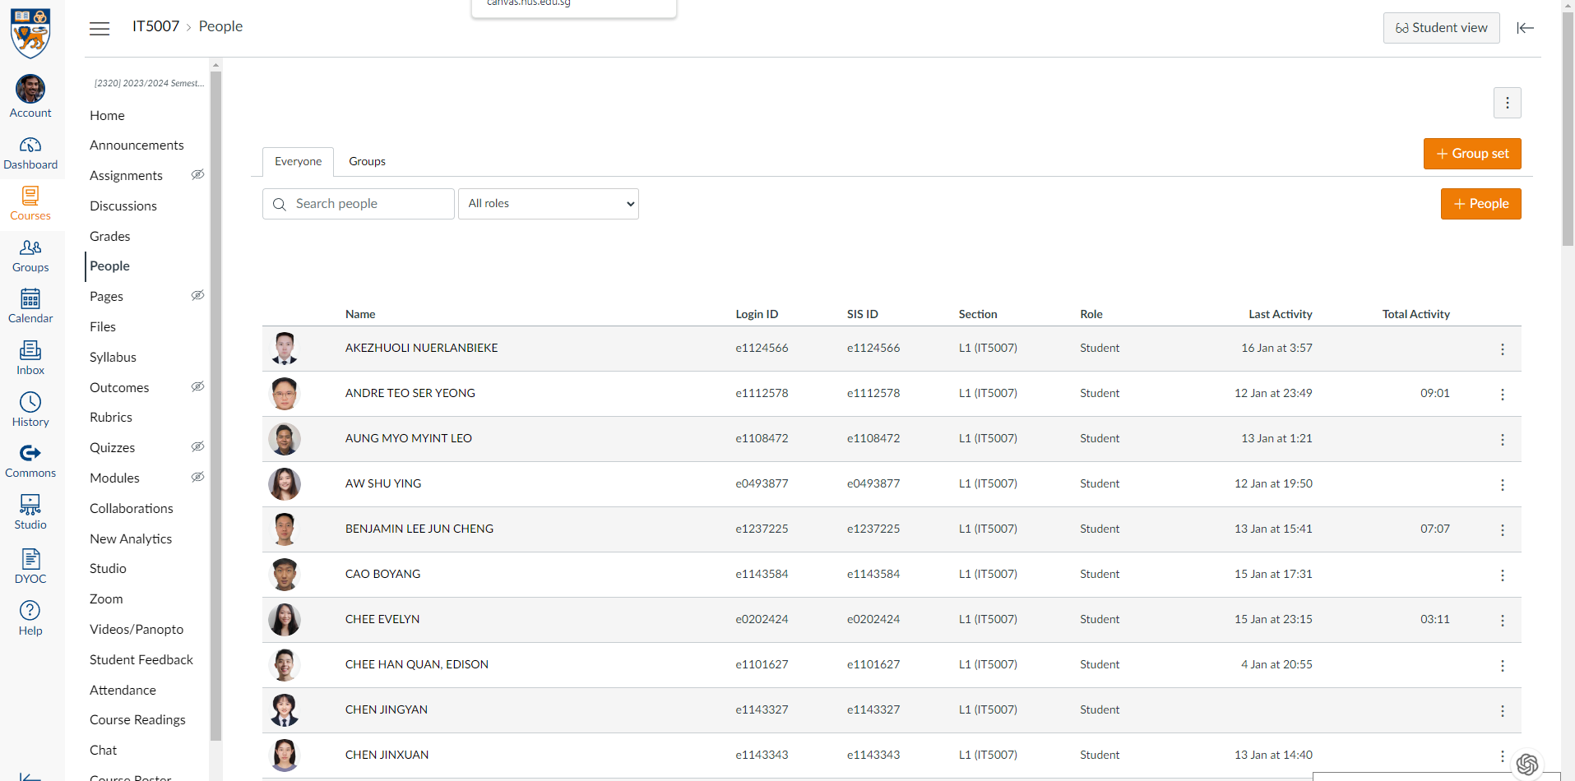
Software Architecture
Display
Business Logic
Data

Slide 20




Mapping Software to Underlying Devices
User Device
Internet
Server

Slide 21
Reasons for the dynamic ecosystem
Each innovation in underlying systems brought about a new software dev product!
What were the innovations/changes over the years?

Slide 22
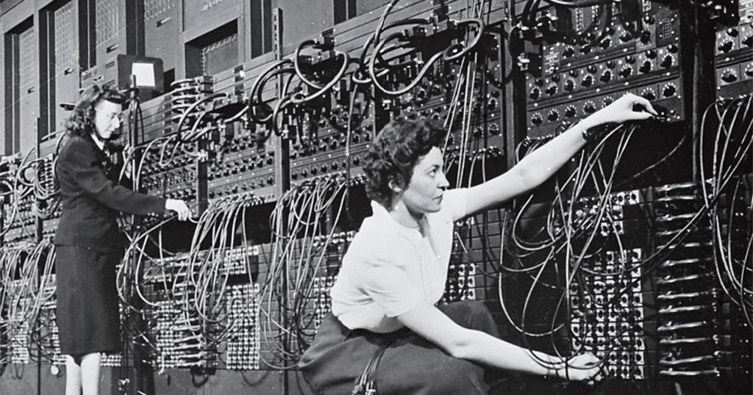
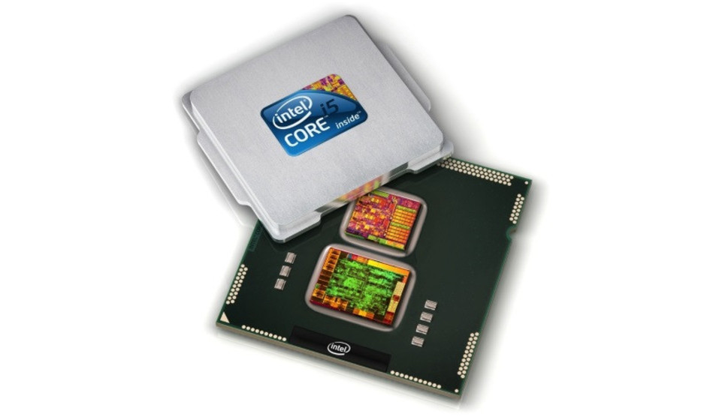
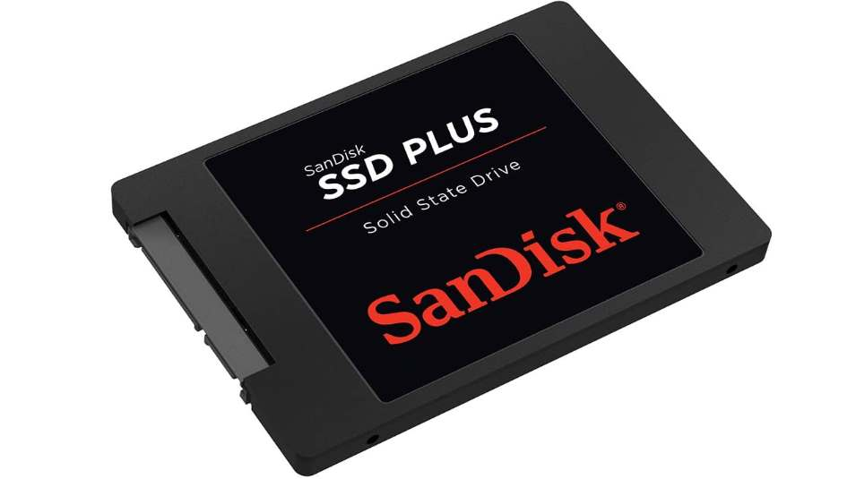
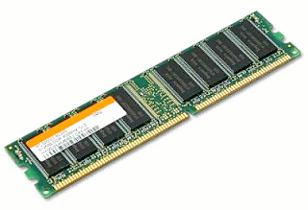
Reasons for the dynamic ecosystem
Server-side innovations [1990 onwards]
High powered CPU [Multi-core, Multi-processor, high-speed computing]
Larger Storages [Several TB]
Larger RAM [TB?]
Future
Carbon nanotubes
Quantum computing
ML accelerators

Slide 23
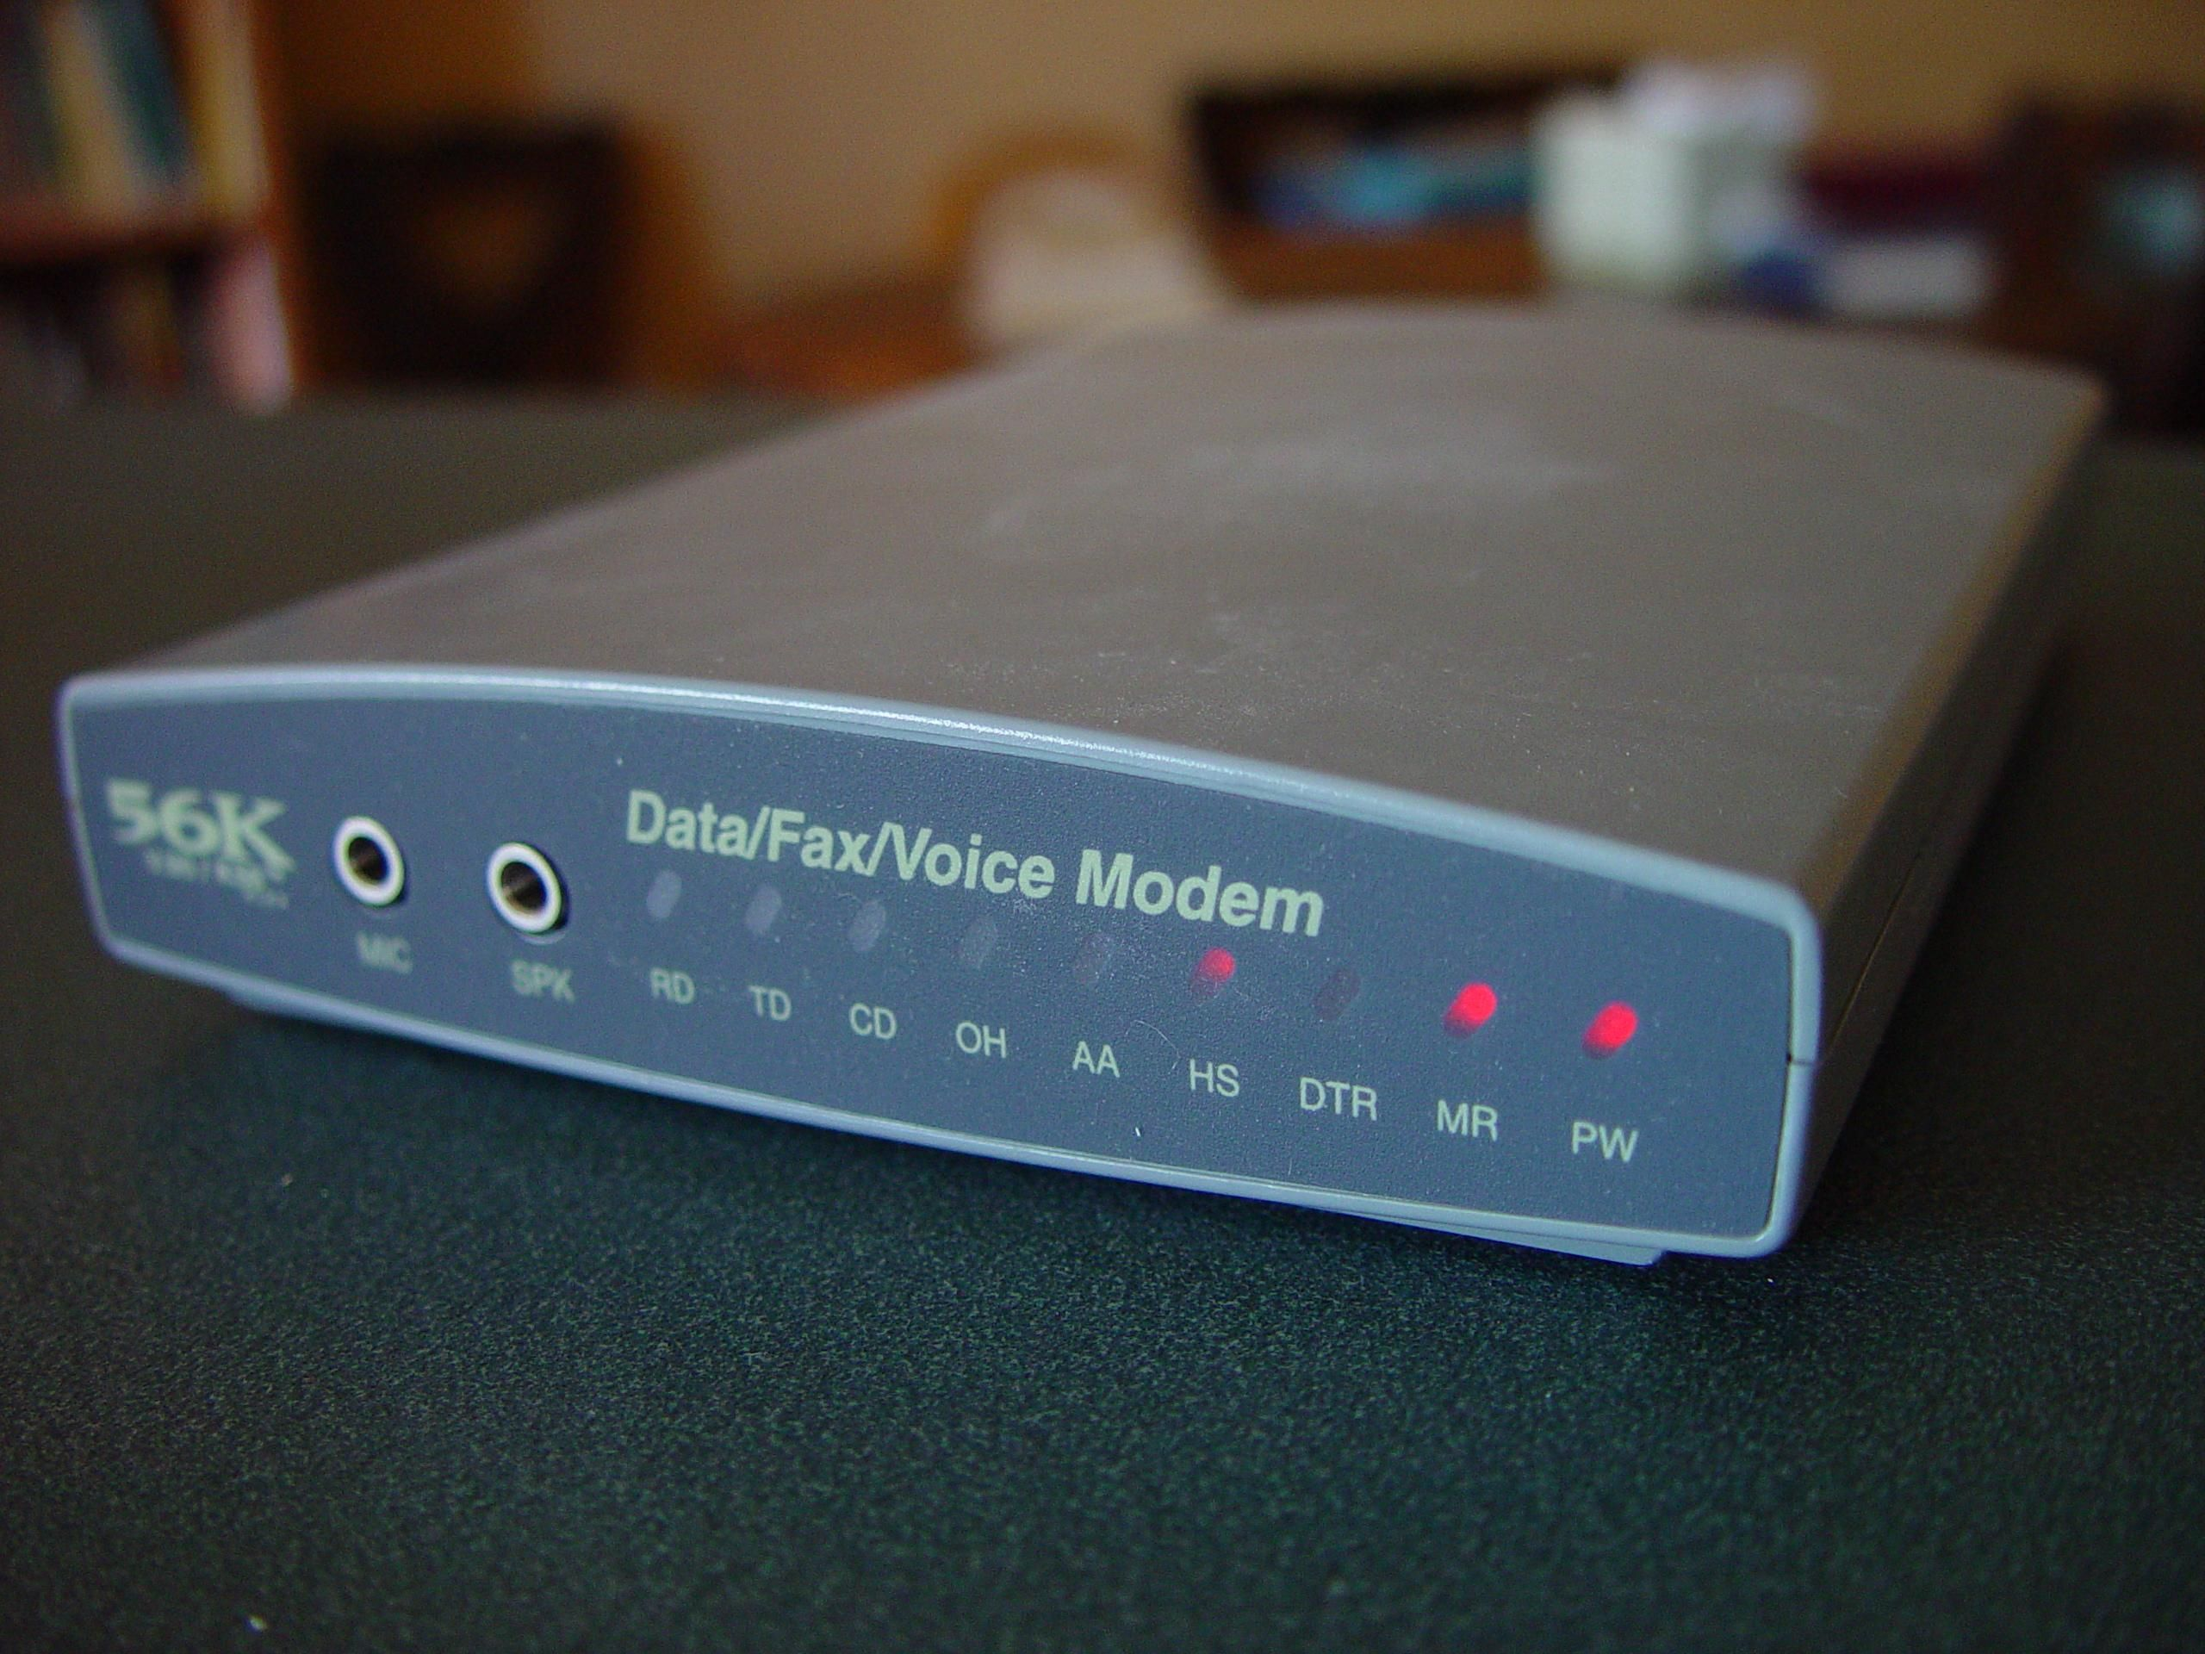
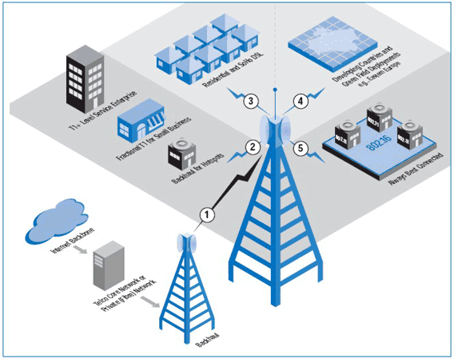

Reasons for the dynamic ecosystem
Network-side innovations [2005 onwards]
Telecom Network (Dial up connections)
Internet innovations (web/browser caching)
2G/3G/4G/5G technologies
Future:
6G + for sure
Edge computing?
Peer-to-peer technologies? (IPFS)

Slide 24
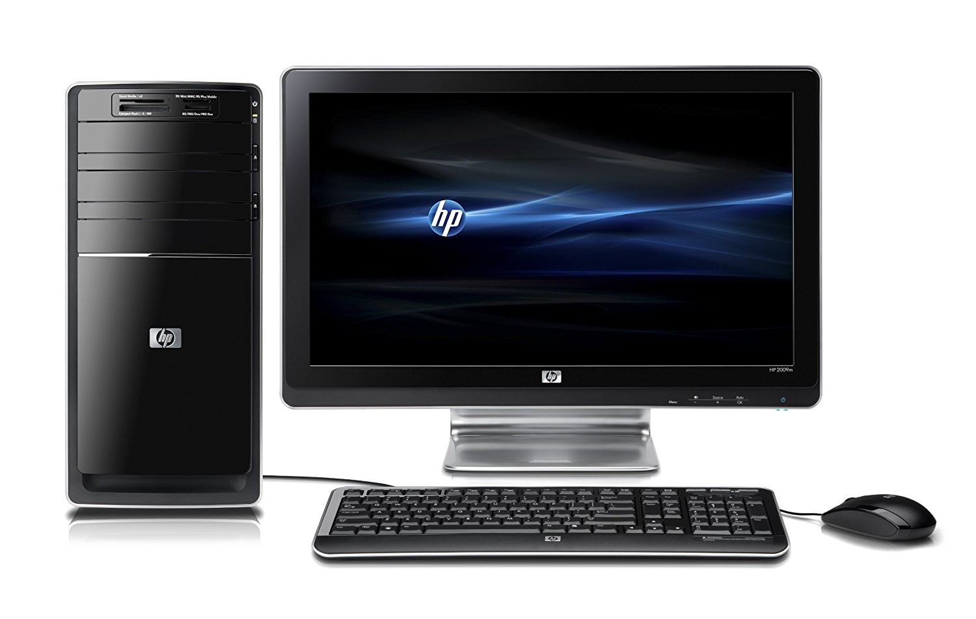
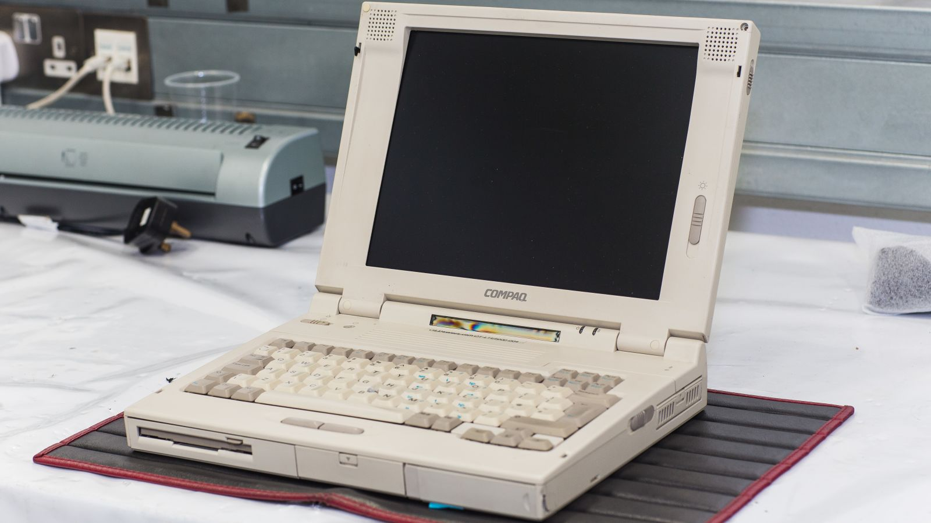
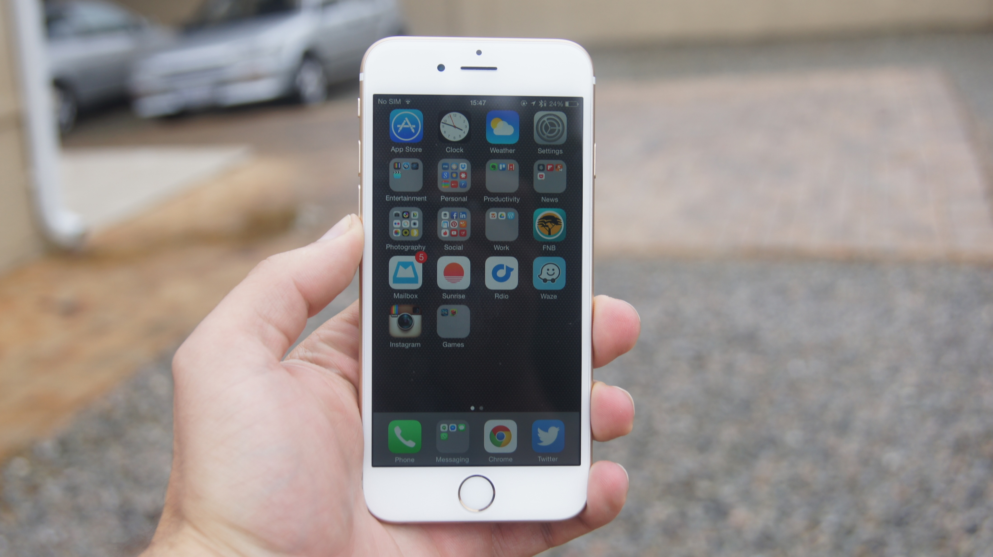
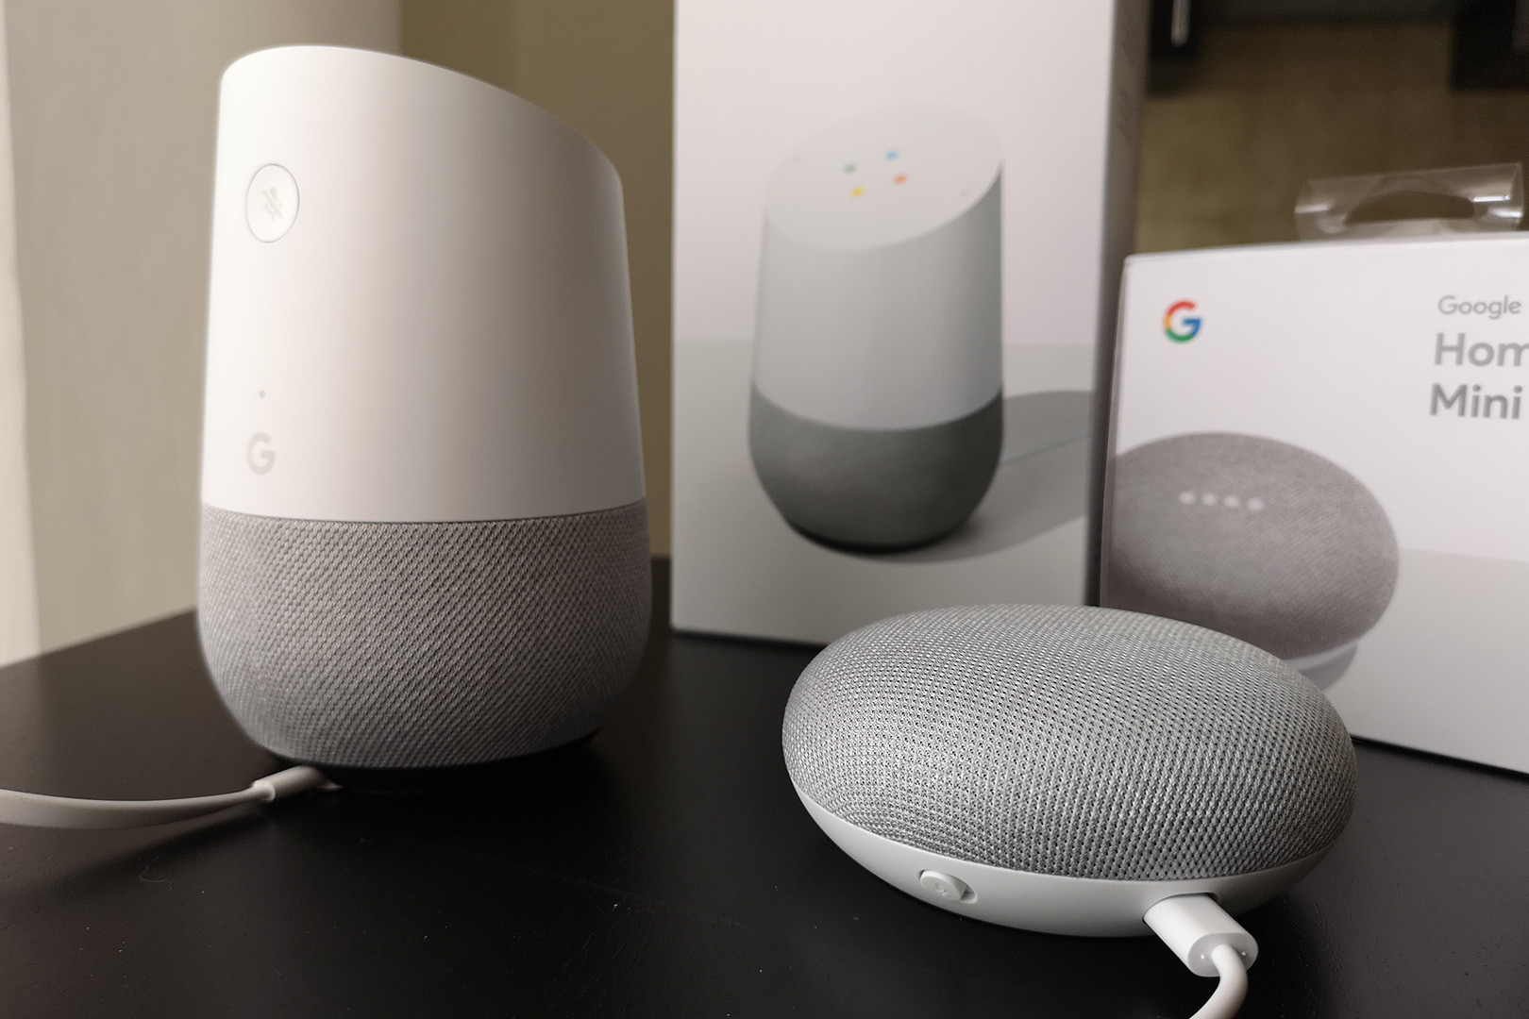
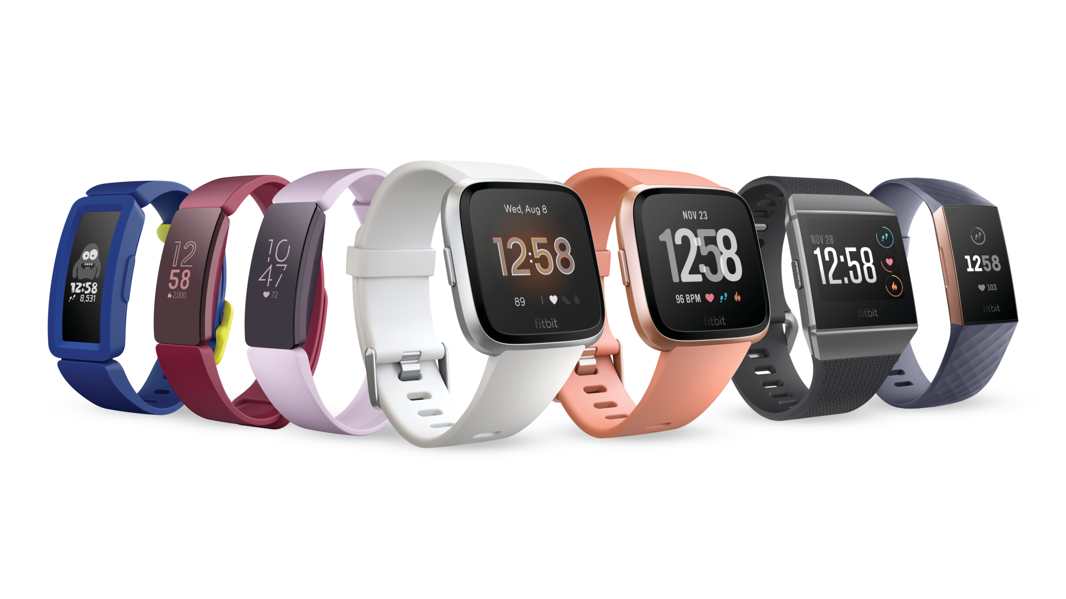
Reasons for the dynamic ecosystem
User device-side innovations [2012 onwards]
Desktop
Laptop
Mobile phones
IoT Devices
Wearables

Slide 25
Reasons for the dynamic ecosystem
Business Logic [Startup boom!]
Machine Learning/Analytics
Security issues
Interactive applications
Future?
Virtual Reality
Augmented Reality
What next? Send in your comments!

Slide 26
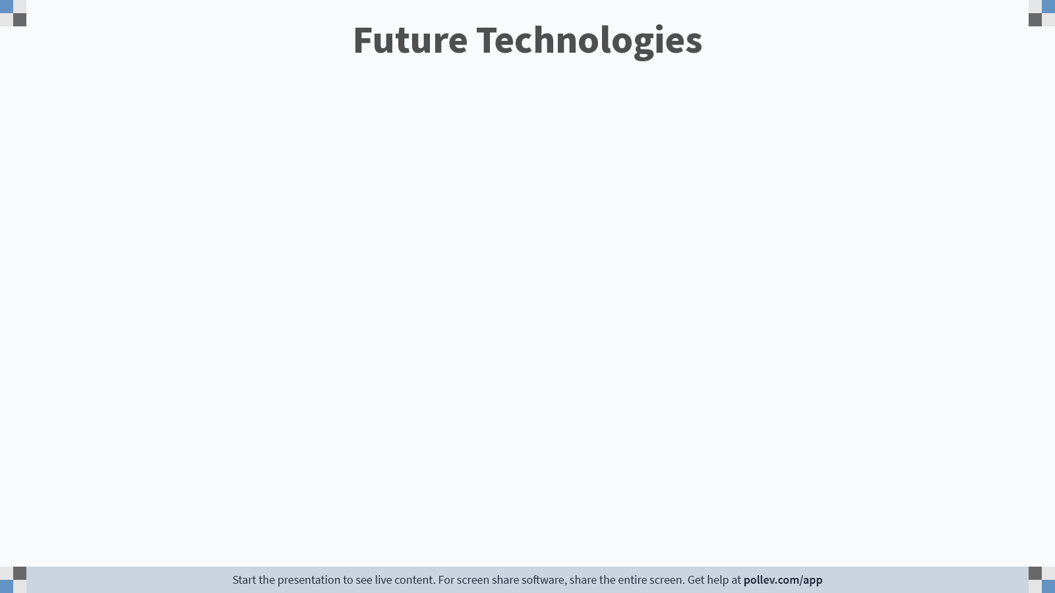
Notes:
Poll Title: Do not modify the notes in this section to avoid tampering with the Poll Everywhere activity. More info at polleverywhere.com/support Future Technologies https://www.polleverywhere.com/free_text_polls/z8xEZWxPDz1PUAinQ4sVf

Slide 27
Walk down the memory lane..
Let us look at historical turning points and how it affected our software design!

Slide 28
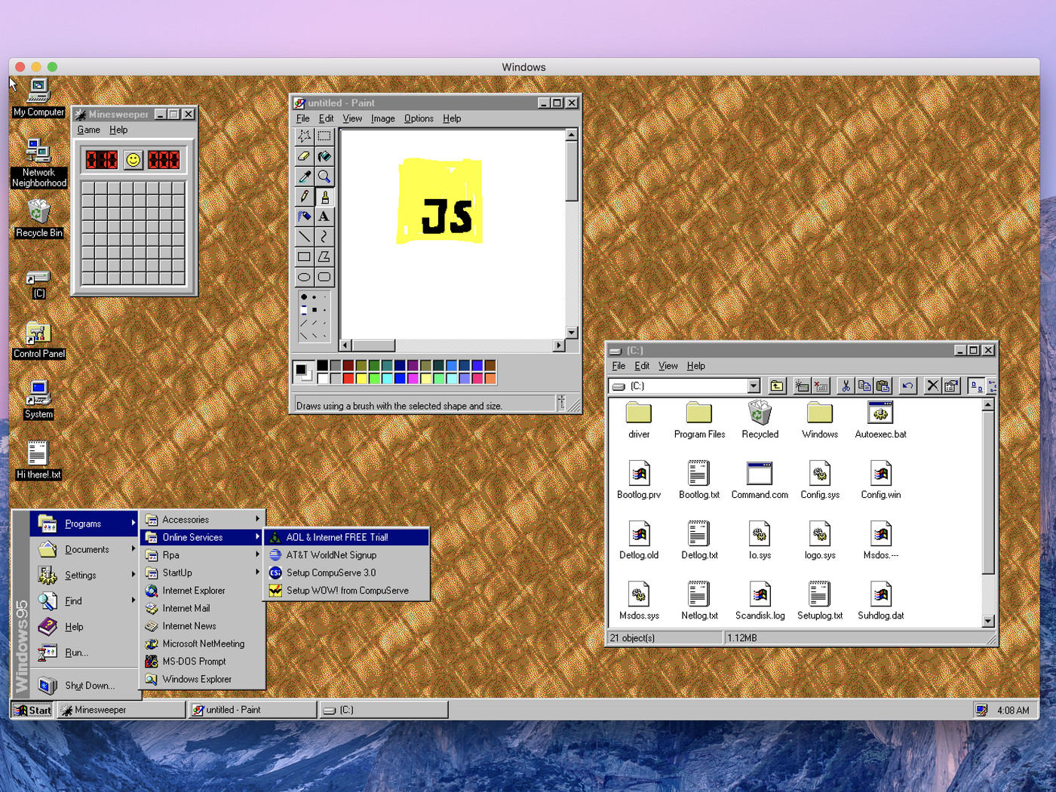
Example-1 (1990s Desktop Application)
Old Computer
Slow Internet
Slow Server

Slide 29
Example-1 (1990s Desktop Application)

Slide 30
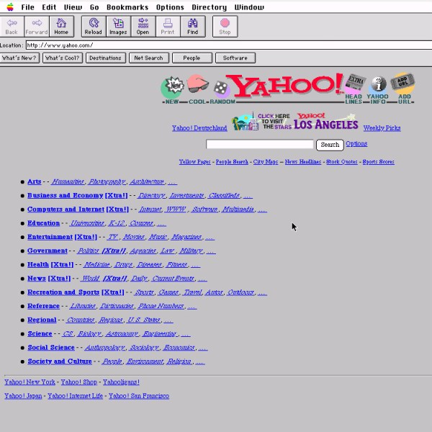
Example-2 (1990s Web Application)
Old Computer
Slow Internet
Slow Server

Slide 31
Example-2 (1990s Web Application)

Slide 32
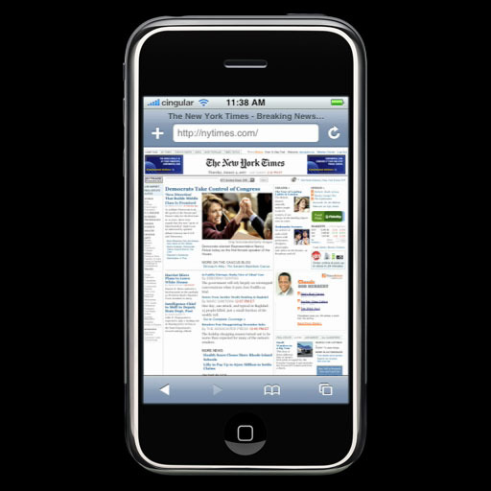

Example-3 (2004, Arrival of Mobile Devices)
Old Mobile Phone
Slow Internet
Faster Server

Slide 33
Example-3 (2004, Arrival of Mobile Devices)

Slide 34
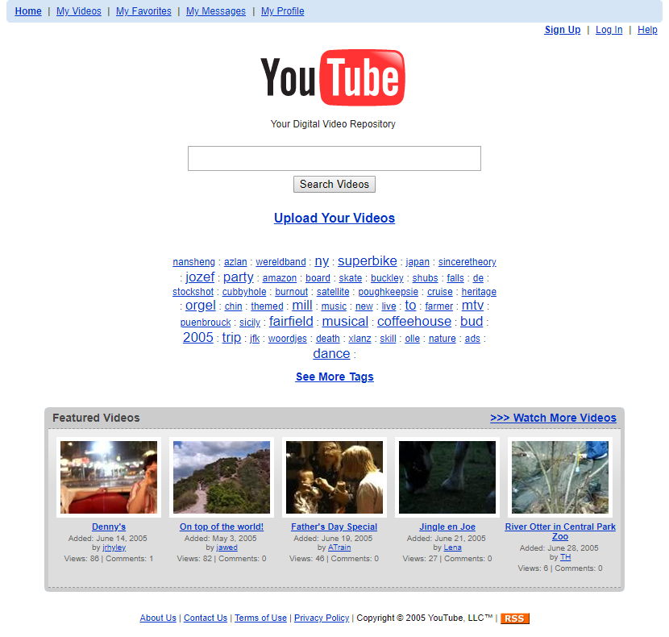
Example-4 (2005 Web Application)
Faster Computer
Slow Internet
Faster Server

Slide 35
Example-4 (2005 Web Application)

Slide 36
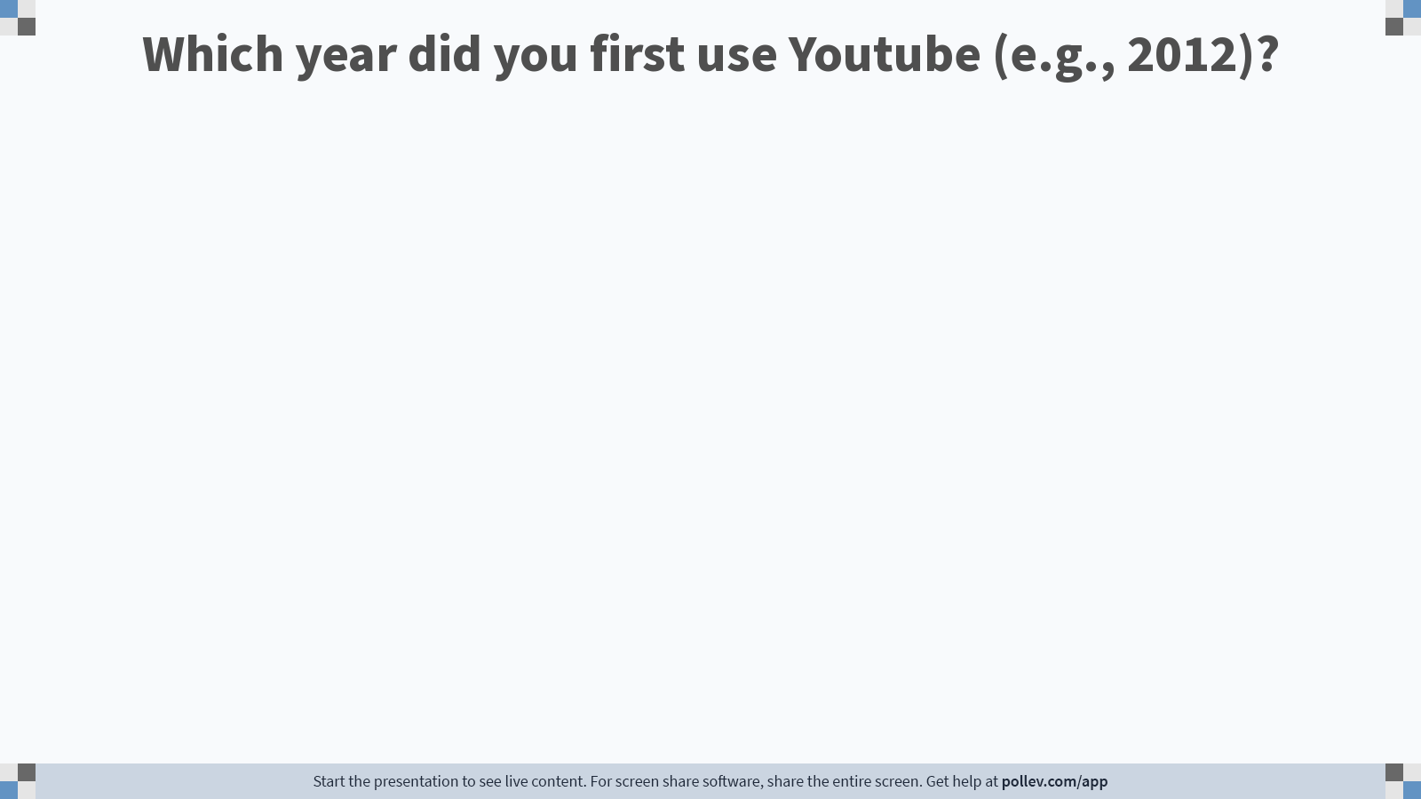
Notes:
Poll Title: Do not modify the notes in this section to avoid tampering with the Poll Everywhere activity. More info at polleverywhere.com/support Which year did you first use Youtube (e.g., 2012)? https://www.polleverywhere.com/free_text_polls/oX0EeqfQjIJRkqYb8gbPq

Slide 37
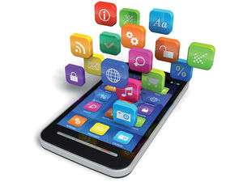

Example-5 (2010, Cloud Computing)
Portable devices with less storage
Moderately Fast Internet
Super Fast Servers

Slide 38

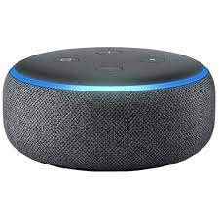
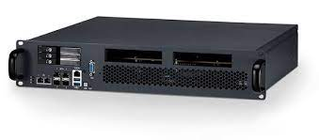
Example-6 (IoT devices)
Not Fast Enough for Interactive Apps
IoT with less storage, less computation
Fast Internet
Super Fast Servers

Slide 39
The Future
What happens when…
Companies manufacture ultra-small storage devices?
Singtel/ISPs announce free-cheap data plans?
Companies manufacture tiny CPUs with powerful ML accelerators?
People become environment conscious and give up phones/IoT devices?
What happens when VR/AR worlds become the norm?

Slide 40
Open Source and Legal Aspects
Notes:
Webinar
Ask questions – raise hand or type questions in Q&A

Slide 41
Key question
Can I copy lines of code from Github?

Slide 42
Opensource basics
Definition: The author grants users the right to use, study, change, distribute software (and its source code).
Free software
Linux (old folks)
Github (gen next)
Visual Studio code, Git, LaTex, Mozilla Firefox, Google Chrome
My personal opinion:
Great for learning
Not so great for commercialization
Why did Linus Torvalds opensource Linux?
Why did Google opensource Chrome browser?

Slide 43
When to OpenSource for commercial purposes?
Let us take Google chrome as an example,
The source code is not directly making your company money.
You are looking to improve your software exponentially.
Your own employees cannot develop the software as fast as you would like.
You want to control the direction of the open source movement! (control what goes into the next-gen product)

Slide 44
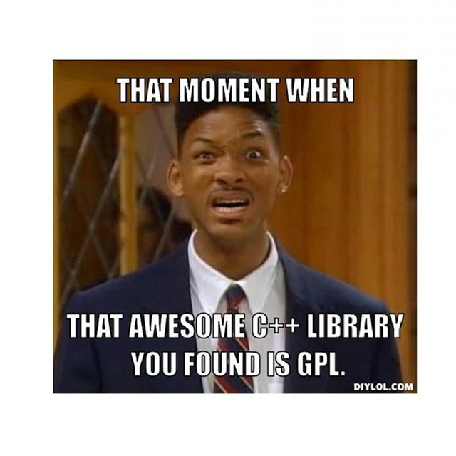
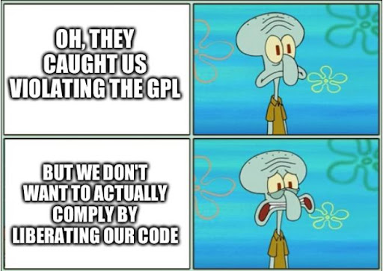

Slide 45
Lawsuits
Free Software Foundation v. Cisco (2008)
Hellwig v. VMware (2019)
Google LLC v. Oracle America (2021)
Lloyd v. Google (2021) [Latest! ☺]

Slide 46
Popular Opensource Licenses
Copyleft (Highly restrictive for commercialization) – GPL license
Semi-Permissive (Moderate restrictions) - LGPL
Permissive (Least restrictions) – MIT license
Resource: https://choosealicense.com/
When in doubt, call your University IP team!

Slide 47
Laws around Software Development
General Data Protection Regulation (GDPR)
Right to information (in a clear, concise way!)
Right of access
Right to be forgotten
Right to object
Personal Data Protection Act (PDPA)
Accountability, notification, consent, purpose limitation, etc.
The government suddenly decides not to host data outside the country. How do we handle this?
Google/Microsoft had to redesign their entire line of production systems to be GDPR compliant!

Slide 48
Commercial Licenses
Copyright is the default fallback. So, do not worry.
Advanced licenses: Trade secret, proprietary license

Slide 49
Food for thought
Can I use ChatGPT for assignments?

Slide 50
Q & A
Notes:
Webinar
Ask questions – raise hand or type questions in Q&A

Slide 51
Web-based Front-end Development
Notes:
Webinar
Ask questions – raise hand or type questions in Q&A

Slide 52
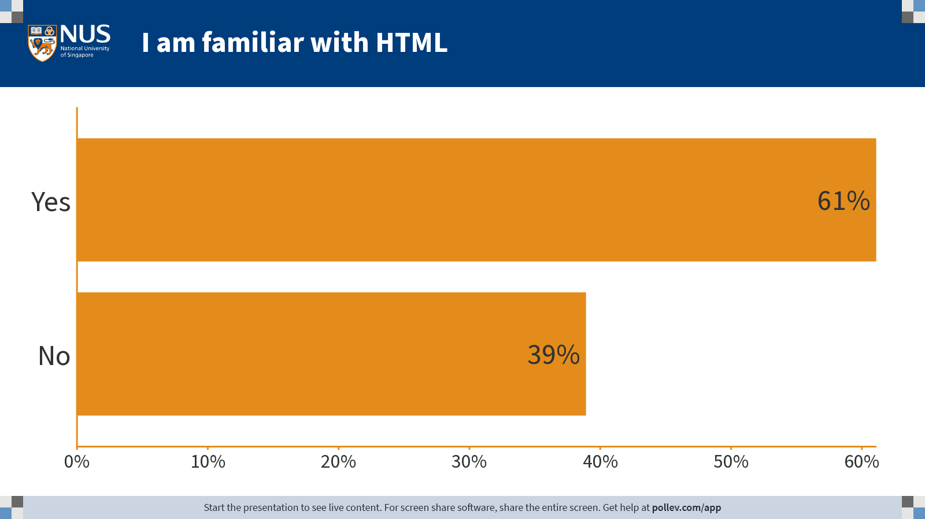
Notes:
Poll Title: Do not modify the notes in this section to avoid tampering with the Poll Everywhere activity. More info at polleverywhere.com/support I am familiar with HTML https://www.polleverywhere.com/multiple_choice_polls/b4uMQAhS1nSNuR2p31W2Q?state=opened&flow=Default&onscreen=persist

Slide 53
Three Types of Websites
Notes:
Webinar
Ask questions – raise hand or type questions in Q&A

Slide 54


Three Types of Websites: Type-1
2-way: Broadcast Information
Res.
Req.
User Device
Internet
Server

Slide 55
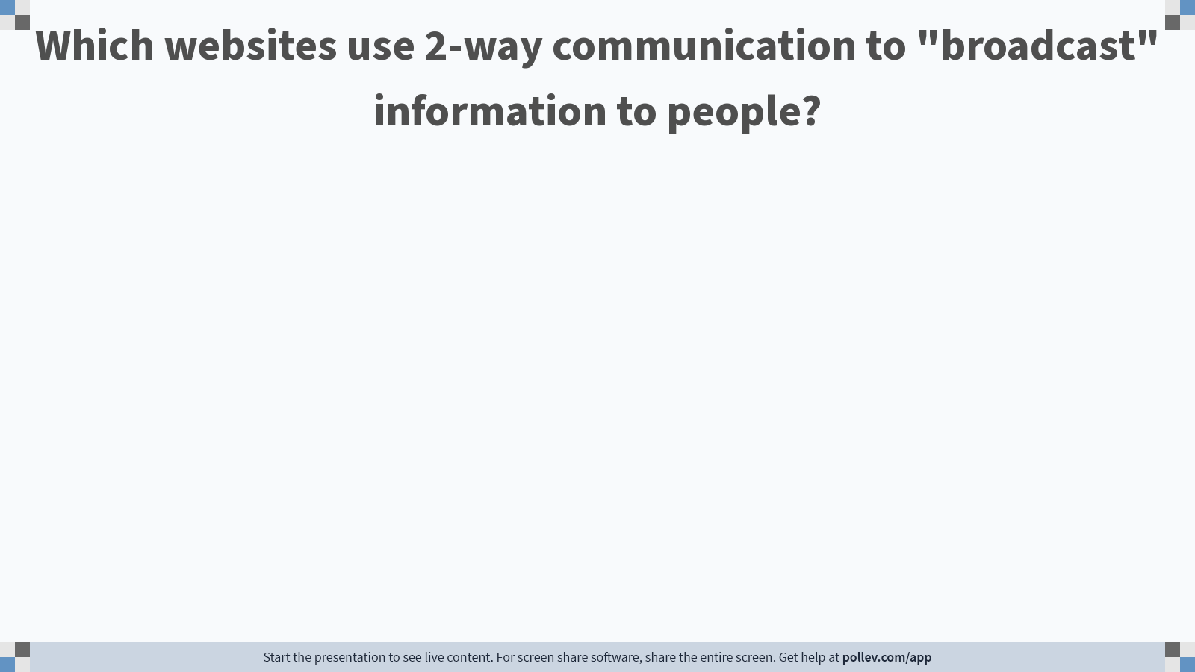
Notes:
Poll Title: Do not modify the notes in this section to avoid tampering with the Poll Everywhere activity. More info at polleverywhere.com/support Which websites, in your opinion, use 1-way communication? https://www.polleverywhere.com/free_text_polls/f7tQVufX0k3F9sfvtfy0b

Slide 56
Three Types of Websites: Type-2
3-way: Broadcast Information and Collect User Data
Res.
Req.
Data
User Device
Internet
Server

Slide 57
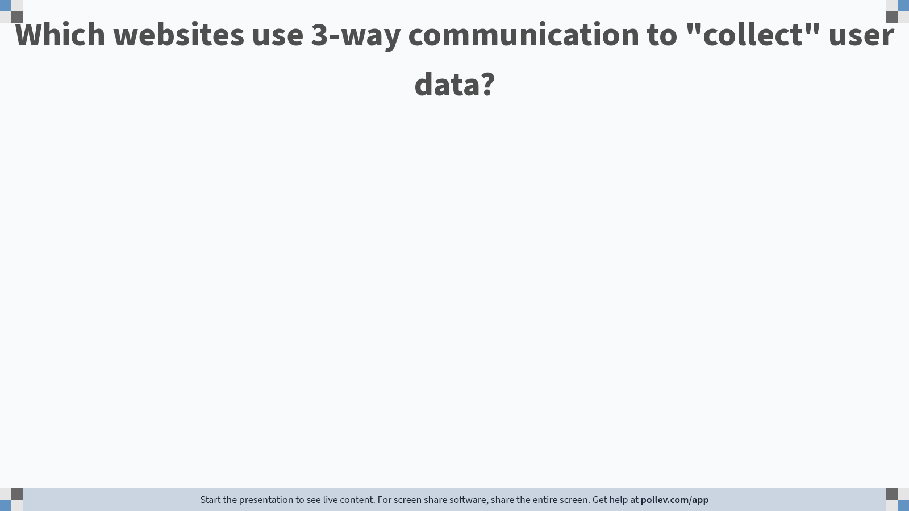
Notes:
Poll Title: Do not modify the notes in this section to avoid tampering with the Poll Everywhere activity. More info at polleverywhere.com/support Which websites, in your opinion, use 3-way communication to collect user data? https://www.polleverywhere.com/free_text_polls/MPcOI1Z3p58DAQ1lMfKiz

Slide 58
Three Types of Websites: Type-3
4-way: Collect User Data and customize experience
Res.
Customize Experience
Req.
Data
User Device
Internet
Server

Slide 59
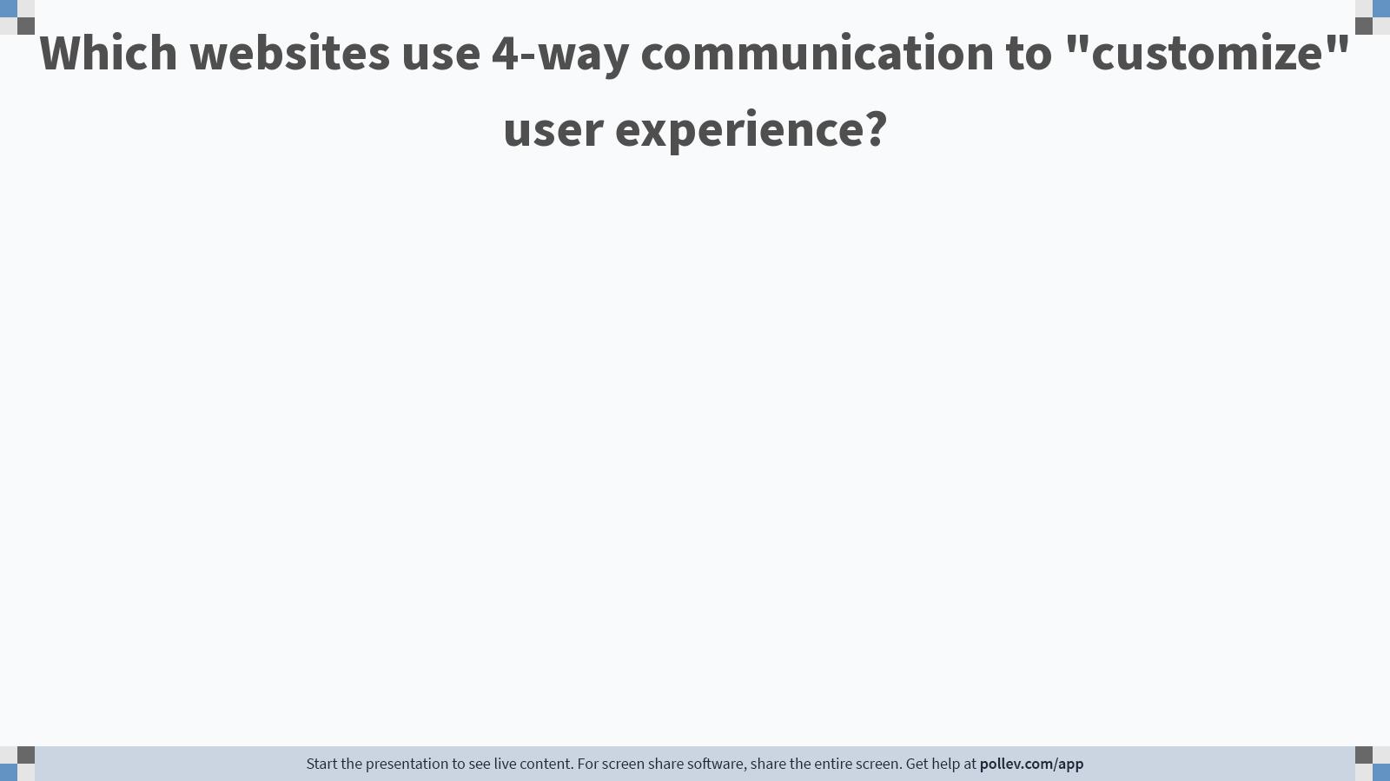
Notes:
Poll Title: Do not modify the notes in this section to avoid tampering with the Poll Everywhere activity. More info at polleverywhere.com/support Which websites use 4-way communication to "customize" user experience? https://www.polleverywhere.com/free_text_polls/0JbrPCIBCYJtrto3gJm7o

Slide 60

Wearing the Developer hat
Notes:
Webinar
Ask questions – raise hand or type questions in Q&A

Slide 61
Where does the developer write their code?
User Device
Internet
Server
This Photo by Unknown Author is licensed under CC BY-SA

Slide 62
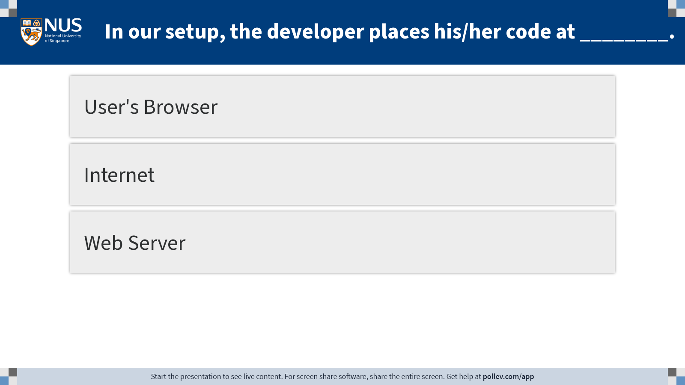
Notes:
Poll Title: Do not modify the notes in this section to avoid tampering with the Poll Everywhere activity. More info at polleverywhere.com/support In our setup, the code written by the developer is placed at ________? https://www.polleverywhere.com/multiple_choice_polls/qQ5zadbZn6LP3HpO8YWjO?display_state=instructions&activity_state=opened&state=opened&flow=Engagement&onscreen=persist

Slide 63
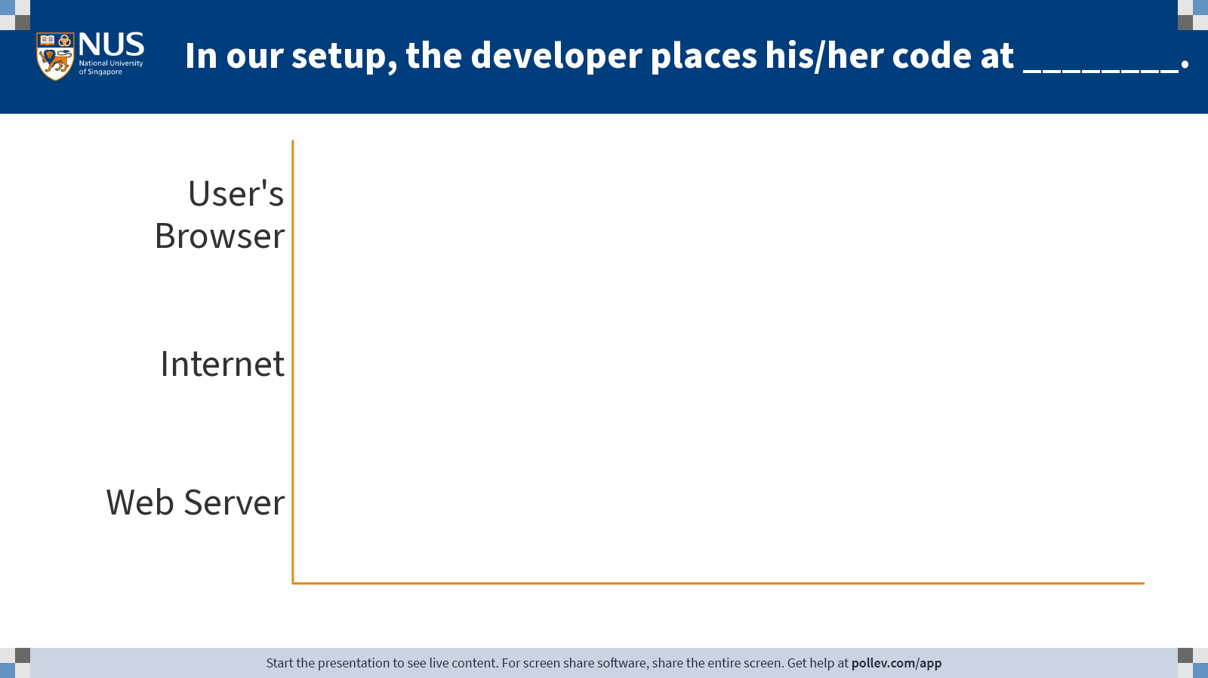
Notes:
Poll Title: Do not modify the notes in this section to avoid tampering with the Poll Everywhere activity. More info at polleverywhere.com/support In our setup, the code written by the developer is placed at ________? https://www.polleverywhere.com/multiple_choice_polls/qQ5zadbZn6LP3HpO8YWjO?display_state=chart&activity_state=opened&state=opened&flow=Engagement&onscreen=persist

Slide 64
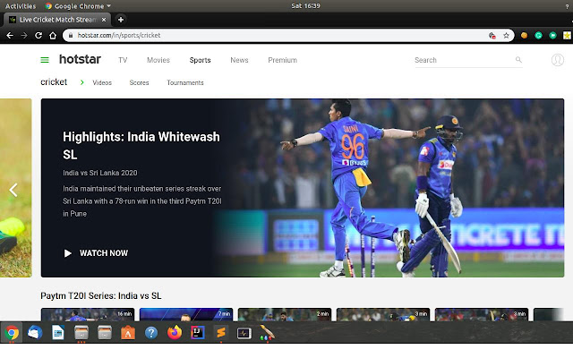




Where does the developer add/host code?
User Device
Internet
Server
This Photo by Unknown Author is licensed under CC BY-SA

Slide 65
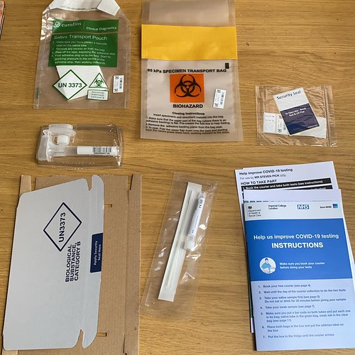
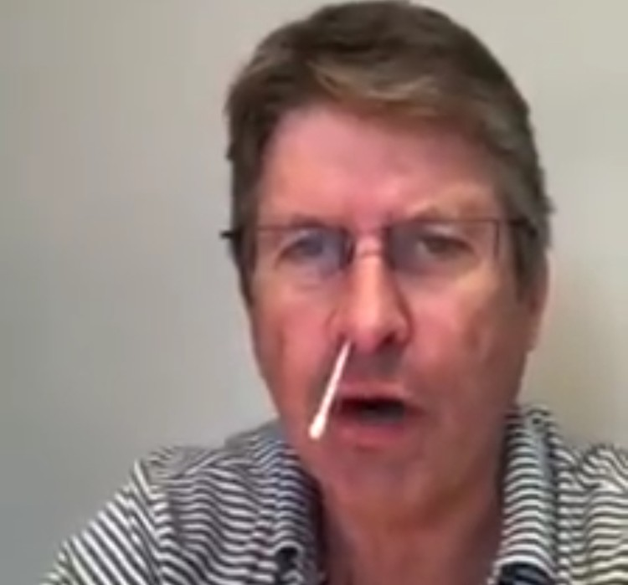
Analogous to Covid Self-Test Kits!
Ensure all components are present
Neatly Package them
Allow people to use it in the way they want
Citizens
Postal Service
Government
This Photo by Unknown Author is licensed under CC BY-SA

Slide 66

Hotstar (A practical Example)
User Device
Internet
Server
This Photo by Unknown Author is licensed under CC BY-SA

Slide 67

Understanding the deployment ecosystem
Hardware (CPU/GPU)
OS
OS
Hardware (CPU/GPU)
OS
OS
Who Converts HTML/CSS/JS to Binary code?
Binary
Code
User Device
Internet
Server
This Photo by Unknown Author is licensed under CC BY-SA

Slide 68












Browser Ecosystem
Browser Engines
Blink
Presto
Gecko
Webkit

Slide 69



Browser Engine
HTML Engine
Javascript Engine
CSS Engine

Slide 70
Focus of this Lecture
Hyper Text Markup Language (circa 1990)
Hyper Text: Not just text! e,g,. Images, links, videos, etc. can be shown to user

Slide 71

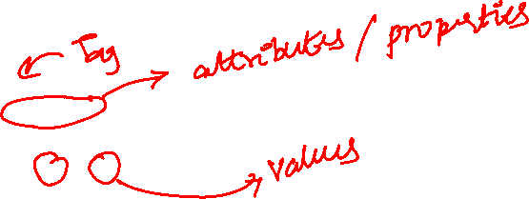
Example of a Mark-Up Language
5,5
As a developer, send the triangle to the user’s browser for their viewing.
What are your options today?
Send it to them as an image (jpg, png, etc.)?
What is the size of the image?
How about the time it takes to download it?
Is there an efficient way?
0,0
10,0
<Triangle>
<vertex x=0, y=0></vertex>
<vertex x=5, y=5></vertex>
<vertex x=10, y=0></vertex>
<color value=green></color>
</Triangle>
Takeaway: Text consumes less space than complex objects.

Slide 72
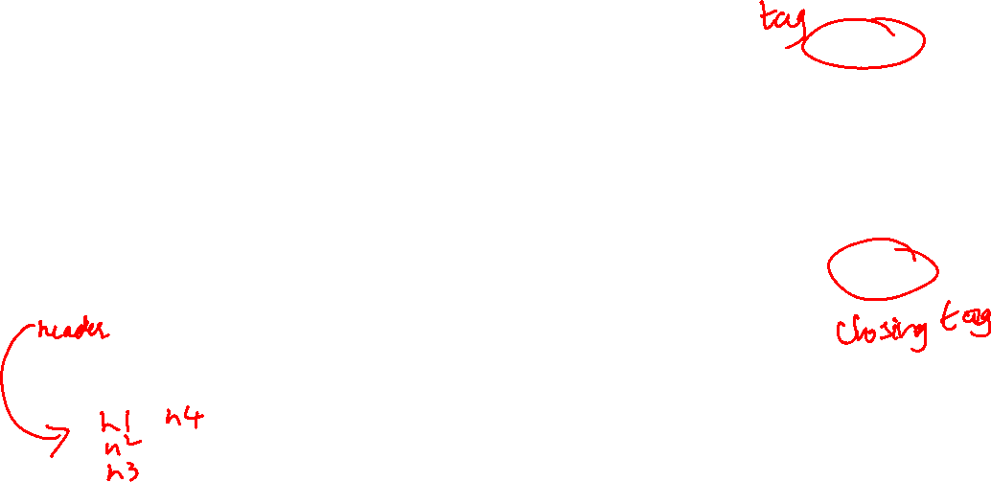
HTML Basics
<!DOCTYPE html>
<html>
<head>
<title>My First Document</title>
</head>
<body>
<h1>My First Heading</h1>
<p>My first paragraph.</p>
</body>
</html>
HTML tags are instructions to the browser.
<HTML> tag specifies the start and end of html document.
<Head> tag specify the header of the document where meta information like the title, included scripts, etc. can be specified.
<Body> tag specifies the body of the document where the core logic for your website can be coded. You can include text, image, videos, links, etc.
<h1>, <p> are other tags in HTML. HTML is all about tags and what they can do.
How do I know what these tags do? Refer to MDN web docs (or) w3schools documentation.

Slide 73

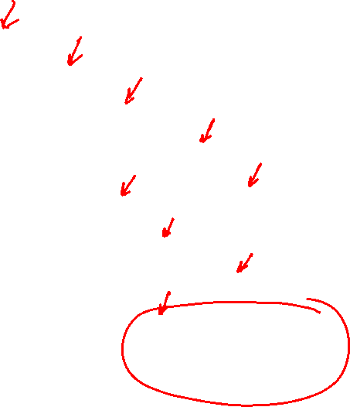
Document Object Model (DOM)
Defines the logical structure of Documents.
Looks like what you see on the right…
Useful for addressing a particular element (e.g., href)

Slide 74
First Website Ever Created
By Who?
And Why?
http://info.cern.ch/hypertext/WWW/TheProject.html
Let us try to learn from the first website ever created!

Slide 75
Moving on to Later 1990s
Web design in 1990s: https://www.webdesignmuseum.org/exhibitions/web-design-in-the-90s
Access these websites using the waybackmachine: https://web.archive.org/
Analyze the changes in a Yahoo! website from 1994, 1996, 2004, 2010.
Let us use the WaybackMachine!

